Slide 1


Clothes dryer Sensor
Oliver Pulley

Slide 2
Purpose
Improve quality of life when drying clothes.
Provide data to the user on their drying.
Customer outreach saw a positive response to the concept.

Slide 3
Sensors
Using the DHT11 temperature and humidity sensor.
Have a chart to show the fluctuation of temperature and humidity.

Slide 4
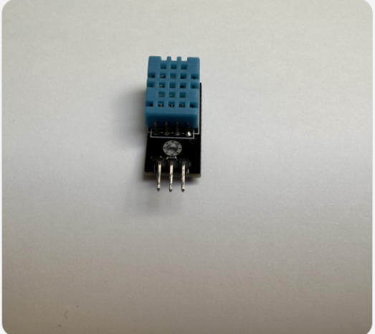

Slide 5
Actuation
Main aim – Send a notification to user on their smartphone when clothes are ready to be taken down.
Uses the Blynk app
Additional features:
Provide the user with the information collected, humidity and temperature.

Slide 6
Network
The device will communicate with the Blynk on the smartphone:
Uses Internet connectivity.
Uses the MQTT protocol for communication

Slide 7
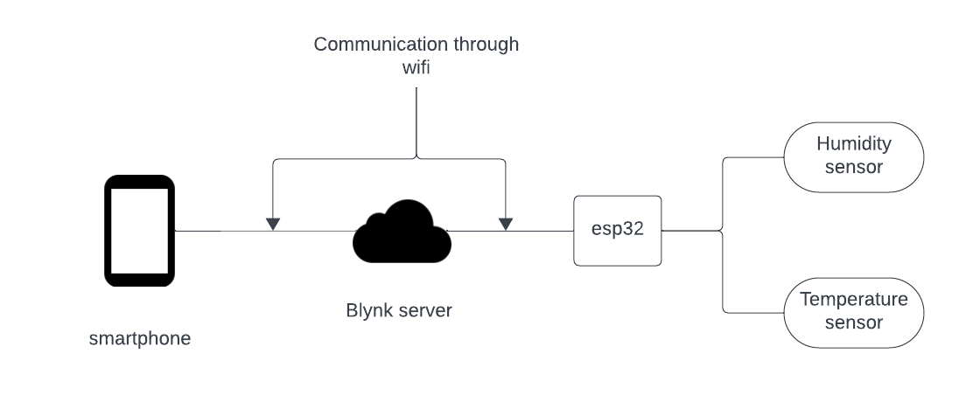

Slide 8
Original Idea + Changes

Slide 9
Original Idea
This focused on using the raw data, temperature and humidity, to signal to user when the clothes were done.
This would also have to use previous samples acquired to know the specific data needed to be “dry”,

Slide 10
Reasons for change
Became impractical in my house to test in time using shared spaces.
Requires multiple uses to find optimal data – would be confusing at first for the customers.
Believed the system to be inefficient.

Slide 11
Changes
Focused on developing a timer instead.
Based on the readings of the room that is then used in a formula to determine the time.
Simpler and easy access for customers – just click the button to generate time when clothes set up.

Slide 12
Formula
Simple formula for this project.
Time = Constant / temperature x (1 – humidity)
Constant would be the value that would change depending on external variables.
Chose 50 as the values produced reflected research.

Slide 13
Improved Formula
Research was done into a more improved Formula to increase precision.
Formula curated from Vileda = E = W/M2 ≥ 1 HR + (RH <70%) + (T ≥21C) + (FF8-12)
Lack of additional equipment hindered availability.

Slide 14
Definitions
Evaporation = E
(if preferred) The Heat of Evaporation = ∆Hvap
Dry day, there is no symbol.
Sunshine = W/m2
Relative Humidity = RH
Wind = ff
Temperature = T

Slide 15
Final design

Slide 16
Final design
Best fit for this IOT is incorporated into a clothes rack. Creating a “smart rack”.
This would allow the users to know their rooms temperature and use their phone to set the time when drying.

Slide 17
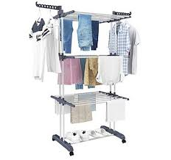
Concept image

Slide 18
Final Design
The device uses WiFi and would have to have a battery to keep the device powered.
Problem would be wasting battery when not in use. – Solution would be to use the different low power modes of esp32.

Slide 19
Final design
Enables an extension on the original idea – Include a new actuator of a heater.
Turn on a heater if the room is considered “not efficient” enough.
Would require a wired powered connection to have a heater equal to others in the market.

